Slide 1
RELEASABLE TO CADETS
AFROTC
Spring 2025
USSF Application Board
RELEASABLE TO CADETS

Slide 2
Overview
PURPOSE: Ensure cadets and Detachment Cadre understand the process of cadet self-nomination for the USSF Application Board
OBJECTIVES:
Instructions for Cadets
Volunteering for a Space Force commission
REFERENCE:
AFROTCI 36-2011 Vol 3, Chapter 14

Slide 3
USSF Spring 2025 Application
Weighted Factors
US Space Force Interview
Why you want to join the USSF
Guardian Ideal
USSF Core Values
RSS
Score from Fall 2024 Det/CC Static Rankings
Physical Fitness Assessment (PFA)
Score from most recent fitness assessment (Fall 2024 or Spring 2025)
Cumulative Grade Point Average
Taken from official college transcript
Based on Fall 2024
A Tech Degree is not required to join the USSF
The composite of USSF categorization weighted factors are used to create a cadet order of merit (OM.)
RELEASABLE TO CADETS
Notes:
This slide visually depicts how the cadets is racked and stacked during the board process via the Order of Merit (OM).
The USSF OM is 50% USSF interview, The remaining 50% are performance factors.
The largest factor is the USSF interview which is weighted at 50% of the total OM. While this may seem high, it is backed by empirical validity and represents the highest correlation between information about a candidate and a measure of job performance
The remaining score is comprised of RSS (30%), CGPA (15%), and PFA (5%)

Slide 4
Instructions for Cadets to Volunteer for the U.S. Space Force
RELEASABLE TO CADETS
RELEASABLE TO CADETS
This applies to FY27/FY28 cadets who choose to volunteer for a commission into the Space Force
Notes:
Eligible cadets for this board are those AS200/250/500 with a Date of Commission (DOC) of FY27 (Traditional / 4yr degree program) and FY28 Advanced EA (SAF-approved 5 year degree program).

Slide 5
IMPORTANT: You are volunteering for an Enrollment Allocation (EA) into the USSF. If selected for a USSF EA, you will be tracked to commission into the USSF upon successfully completing the AFROTC program.
RELEASABLE TO CADETS
RELEASABLE TO CADETS

Slide 6
IMPORTANT: Cadets selected for the USSF become ineligible to compete for future USAF categorization or special commissioning opportunities (Rated/ARC/SW/OSI/etc) while still in AFROTC.
RELEASABLE TO CADETS
RELEASABLE TO CADETS
Notes:
Cadets that receive a USSF EA are no longer eligible to compete for any AF position. This includes the Rated Board, Supplemental Rated Board, or any special commissioning opportunities such as Special Warfare, Nursing, OSI, etc....

Slide 7
Overview
RELEASABLE TO CADETS
2) Conduct HireVue interview (cadets receive email with instructions)
3) Board: USSF will select its candidate list first which will then feed into the AFROTC PSP Board. To receive a USSF EA, a USSF candidate must first be on the USSF selection list and have an EA above the national PSP cut line.
1) Complete USSF Survey (MS Form); link provided in ARMS and on slide 12.
RELEASABLE TO CADETS
USSF application process is independent of WINGS; WINGS career preference selections do not initiate/impact this process
Notes:
Broadly, this walkthrough and accompanying ARMs provide guidance on how cadets apply for the USSF Application Board. If you have interested cadets, provide them the link to the USSF Survey. If a cadet completes the USSF survey, they will be forwarded a link to complete a recorded interview. Once scored, the USSF will hold their board using the previously described OM. The USSF candidates will be compared against the AFROTC PSP board to ensure all USSF EAs are above the national PSP cut line.

Slide 8
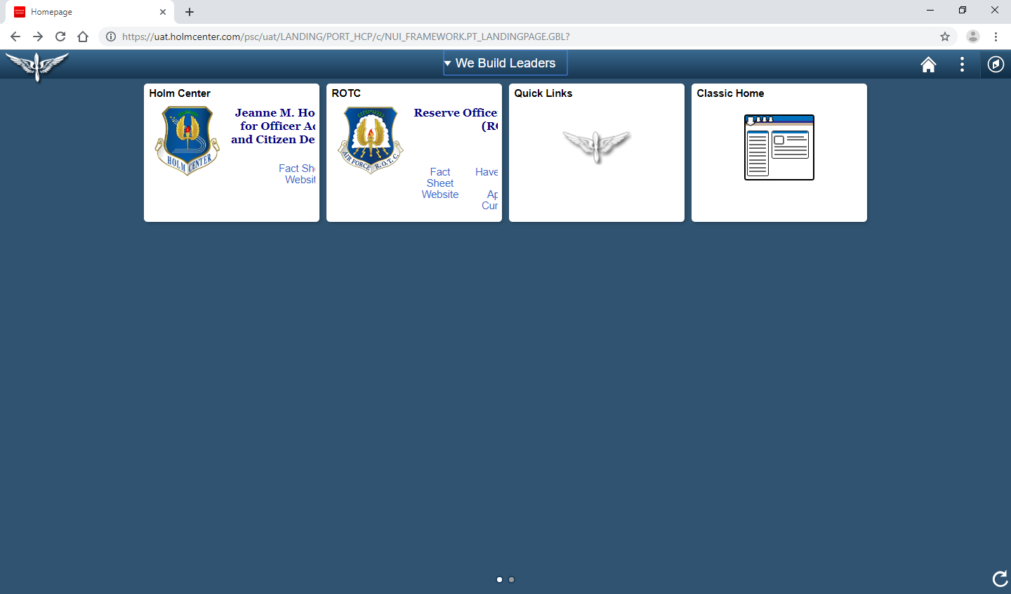
Cadet: Consideration for USSF
RELEASABLE TO CADETS
IMPORTANT: Cadets must update rated preferences prior to Det/CC endorsement for their preferences to populate properly on the Det/CC’s endorsement page. Failing this step may prevent the cadet from meeting the board.
(After the Cadet logs in)
Navigate to Quick Links
RELEASABLE TO CADETS

Slide 9
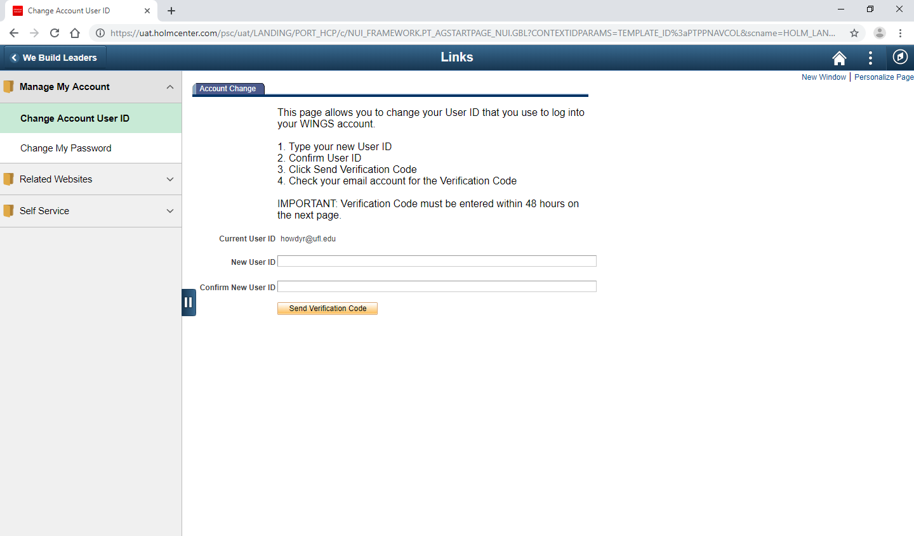
RELEASABLE TO CADETS
Click on Self Service drop down
RELEASABLE TO CADETS

Slide 10
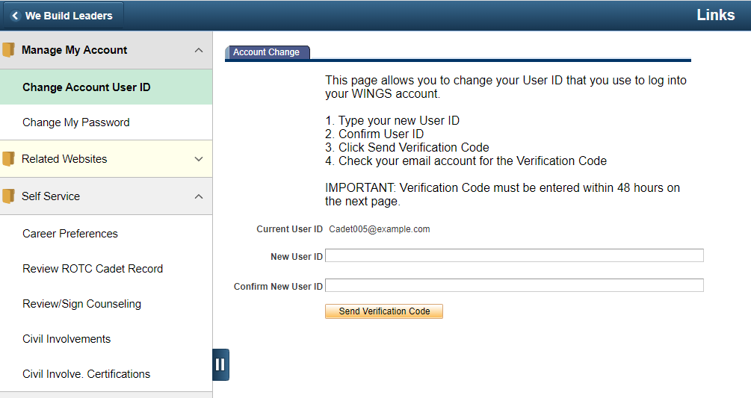
RELEASABLE TO CADETS
Select
RELEASABLE TO CADETS
Notes:
With this update, cadets can select multiple career path preferences beyond the old “Pilot/CSO/RPA/ABM”.

Slide 11
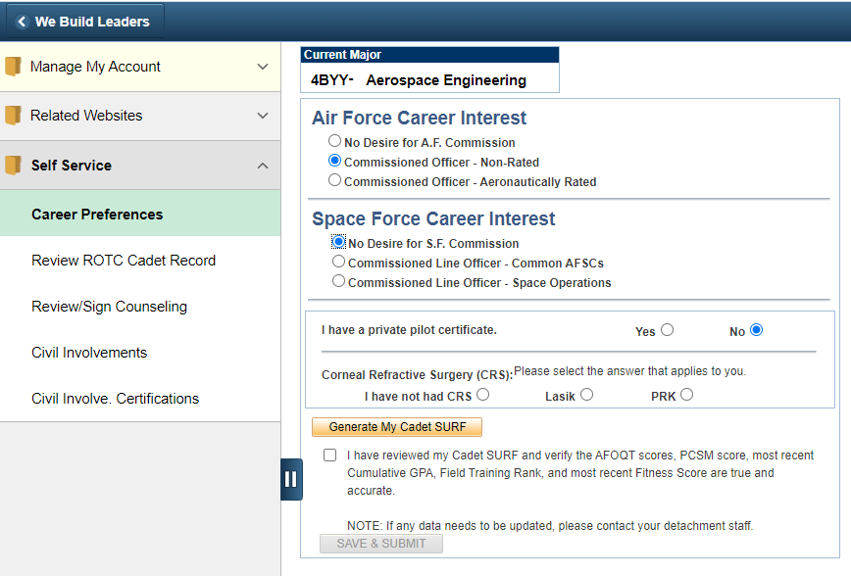
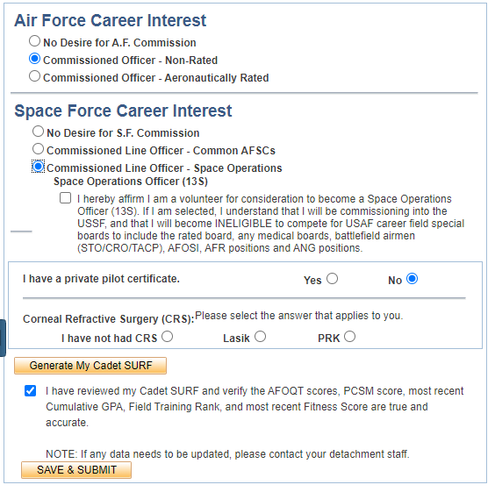
New Nominations
RELEASABLE TO CADETS
1) Select the Commissioned Line Officer – Common AFSC for 14N, 17S, 62E, or 63A
OR Select Commissioned Line Officer – Space Operations, Space Operations Officer (13S)
2) Read and check the volunteer box
3) Click
2) Update (if applicable)
4) SAVE
RELEASABLE TO CADETS
Notes:
With this update, cadets can select multiple career path preferences beyond the old “Pilot/CSO/RPA/ABM”, including ENJJPT and Helo, along with Space Force preference.

Slide 12
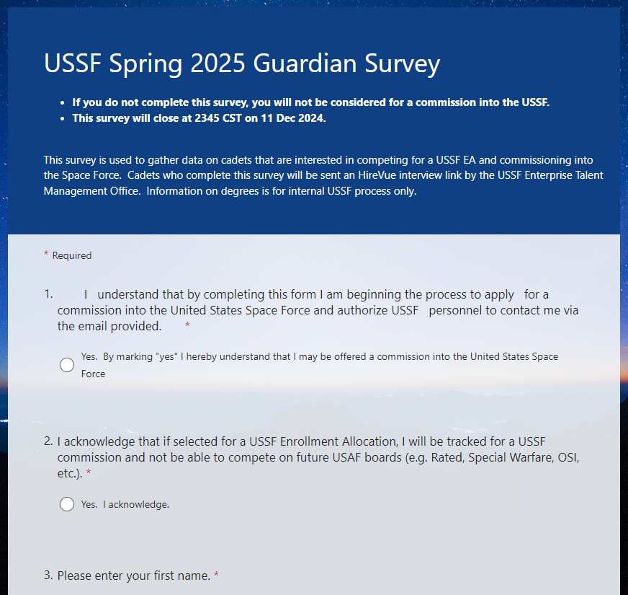
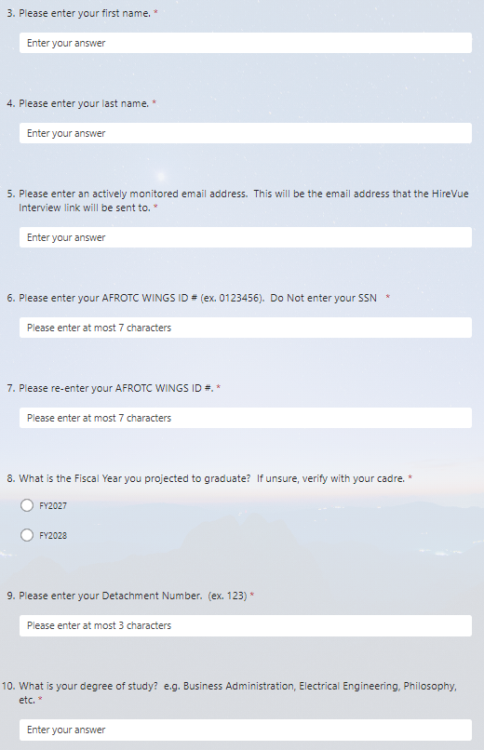
USSF Spring 2025
Guardian Survey Instructions
RELEASABLE TO CADETS
IMPORTANT: Cadets must complete the USSF Guardian Survey for consideration to earn a commission into the Space Force. Failure to complete the survey results in the cadet not being considered (regardless of WINGS career preference selection)
SURVEY LINK:
https://forms.osi.apps.mil/r/RZDmqXZrtL
Fill in basic information
Selecting the box means the cadet volunteers for a USSF commission
RELEASABLE TO CADETS
Notes:
The survey is optional! If a cadet is not interested in the Space Force, they should not complete it.
If a cadet is interested in pursuing a commission into the USSF they MUST complete this survey.

Slide 13
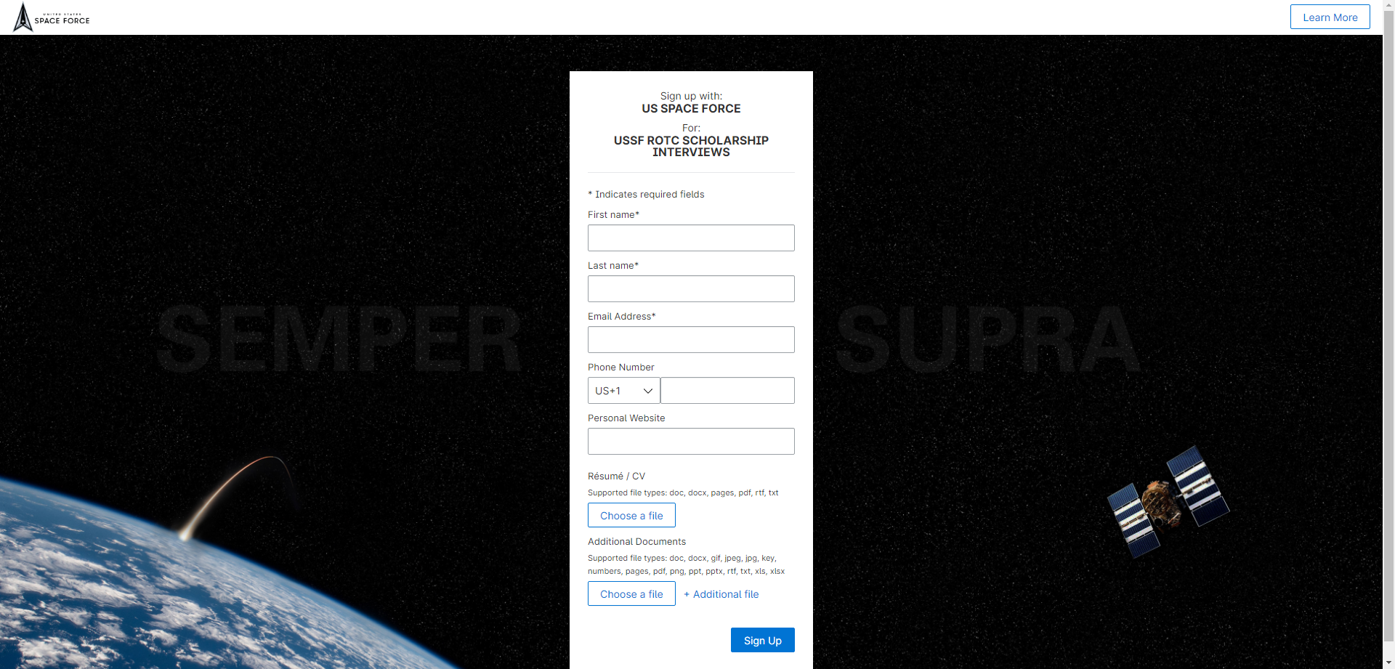
USSF HireVue Interview
RELEASABLE TO CADETS
Cadets who complete USSF Survey will be emailed a link to complete an online interview on the HireVue website
USSF ROTC SELECTION INTERVIEW
The interview is the biggest difference between the AF and USSF orders of merit. Cadets should take this seriously if they want to commission into the USSF. Ability to articulate your desire to join the Space Force and understanding our core values will help. Recommend cadets review the Guardian Ideal
Cadets have 3 minutes to prepare for each question and are allowed 3 minutes to respond to each question. Cadets get 3 attempts per question.
Interview email will have links to interview tips and resources to aid in preparing for the interview
RELEASABLE TO CADETS

Slide 14
USSF Spring 2025 Application Timeline
RELEASABLE TO CADETS
04 Nov 2024: USSF Guardian Survey Opens
11 Dec 2024, 2345CST: USSF Guardian Survey Closes
13 Dec 2024: USSF HireVue Interview Opens
05 Jan 2025, 2359CST: USSF HireVue Interview Closes
06 Jan – 26 Jan 25: Score Interviews
February: AFROTC PSP 25 Board
19 Feb 25 : Projected PSP Official Release Date to Cadets
RELEASABLE TO CADETS

Slide 15
Final Notes
RELEASABLE TO CADETS
It is the cadet's responsibility to ensure that your cadre knows that you are competing for a USSF Enrollment Allocation so that they can verify your records.
It is the cadet's responsibility to ensure that your WINGS preferences are accurate.
It is the cadet's responsibility to ensure that you complete both the USSF Guardian Survey and HireVue Interview before the deadlines. There will be NO EXTENSION to the survey or interview.
It is the cadet's responsibility to provide an email that they will actively monitor for instructions and links to the HireVue Interview process.
It is the cadet’s responsibility to verify they received the HireVue Interview email if they completed the Guardian Survey. If no email is received by 15 Dec 2024, they must contact their Cadre NLT 17 Dec 2024 to receive the interview link.
RELEASABLE TO CADETS

Slide 16
Questions?
RELEASABLE TO CADETS
For questions or concerns, please contact your Detachment Cadre
RELEASABLE TO CADETS

